Slide 1

GUI Application for Encrypting and Decrypting Messages
Submitted To:
Tushar Khitoliya
Submitted By:
Jiya
2210990464

Slide 2

Project Introduction
1
Strengths
Identifying your strengths is the first step in leadership development. It's important to understand what you're naturally good at and where your skills lie. This can help you focus on areas where you can excel and contribute the most.
2
Goal Setting
Setting achievable goals is a crucial part of leadership development. Goals give you a clear direction and a target to aim for. They help you measure progress and keep you motivated. Remember to make your goals SMART - Specific, Measurable, Achievable, Relevant, and Time-bound.
3
Tools & Resources
Gathering the right tools and resources is essential for effective leadership development. This could include books, courses, mentors, and real-world experiences. The right resources can provide valuable insights and help you develop the skills you need to be an effective leader.

Slide 3
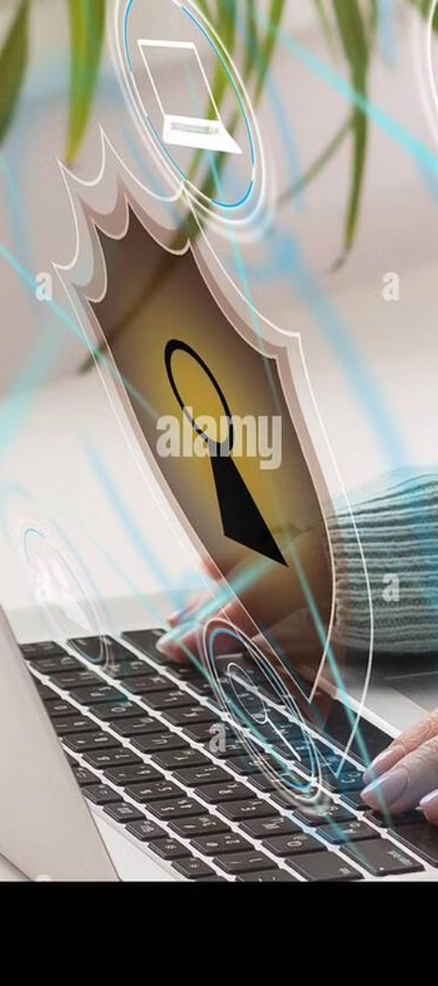
Motivation
1
Increasing Need for Secure Communication
2
Learning Opportunity
This project serves as a learning opportunity for individuals interested in cryptography and programming. By exploring the inner workings of encryption algorithms through hands-on experience, users can enhance their understanding of cybersecurity concepts and develop practical skills that are valuable in today's technology-driven environment.
With the rise of cyber threats and privacy concerns, individuals and organizations are seeking reliable ways to protect their sensitive information from unauthorized access.
3
Promotion of Data Security Awareness
The project is motivated by the desire to promote awareness of data security issues and empower individuals to protect their information in an increasingly interconnected world.

Slide 4
Project Objectives
Enhances Data Security
Promotes Cybersecurity Awareness
Facilitates Learning
Provides a practical tool for users to encrypt their messages, safeguarding sensitive information from unauthorized access.
Offers a hands-on experience for individuals interested in cryptography and programming, enhancing their understanding and skills in these areas.
Educates users about encryption principles and the importance of data privacy in the digital age.

Slide 5
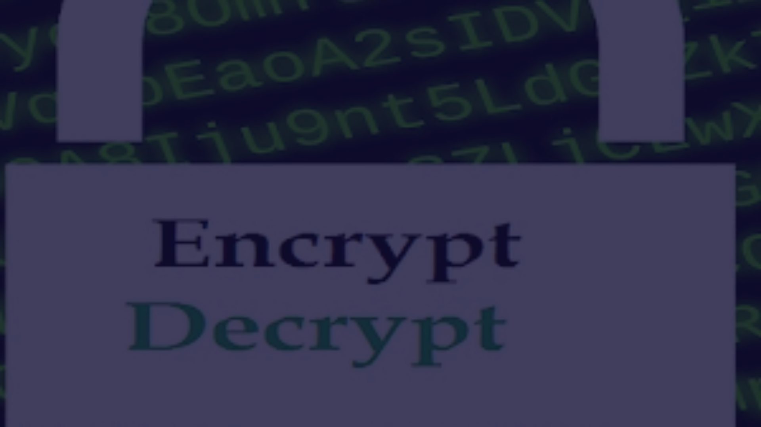
Problem Statement
The problem statement for this project is to develop a GUI application using Python and Tkinter that allows users to encrypt and decrypt messages. The application should provide a user-friendly interface for users to input their messages and choose whether they want to encrypt or decrypt them.

Slide 6

Project Scope and Objectives
1
Develop a User-Friendly Interface
Design a GUI that allows users to easily input their messages and choose whether to encrypt or decrypt them.
2
Implement Encryption and Decryption Algorithms
Create algorithms that rearrange the order of letters in the input message to encrypt it and reverse this process to decrypt it.
3
Handle Edge Cases
Ensure the application can handle messages with odd lengths by adding an extra character to make them even before encryption.

Slide 7
Methodology
Requirement Analysis
Design
Algorithm Development
Design the graphical user interface using Tkinter, taking into consideration user input for messages and choice of encryption or decryption.
Gather and analyze the requirements for the application, including the user interface design, encryption and decryption algorithms, and error handling.
Develop algorithms for encrypting and decrypting messages. The encryption algorithm should the order of letters in the input message, while the decryption algorithm should reverse this process

Slide 8

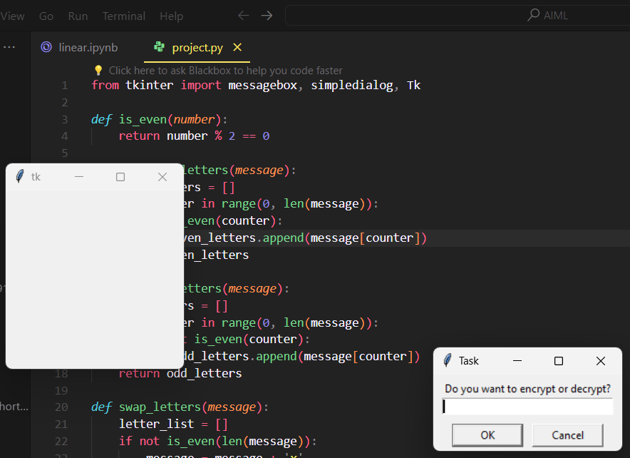
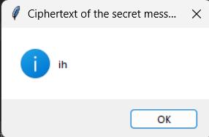
Expected Outcomes

Slide 9
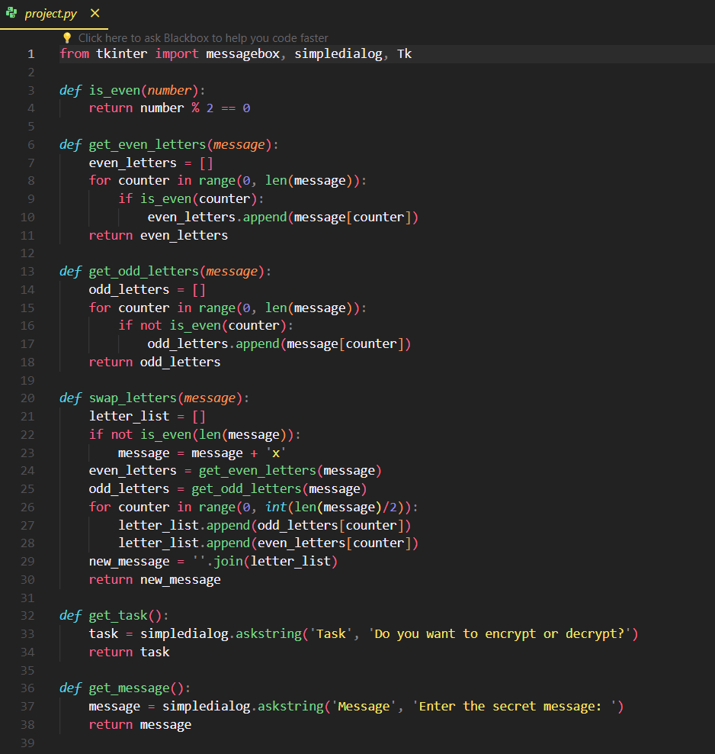
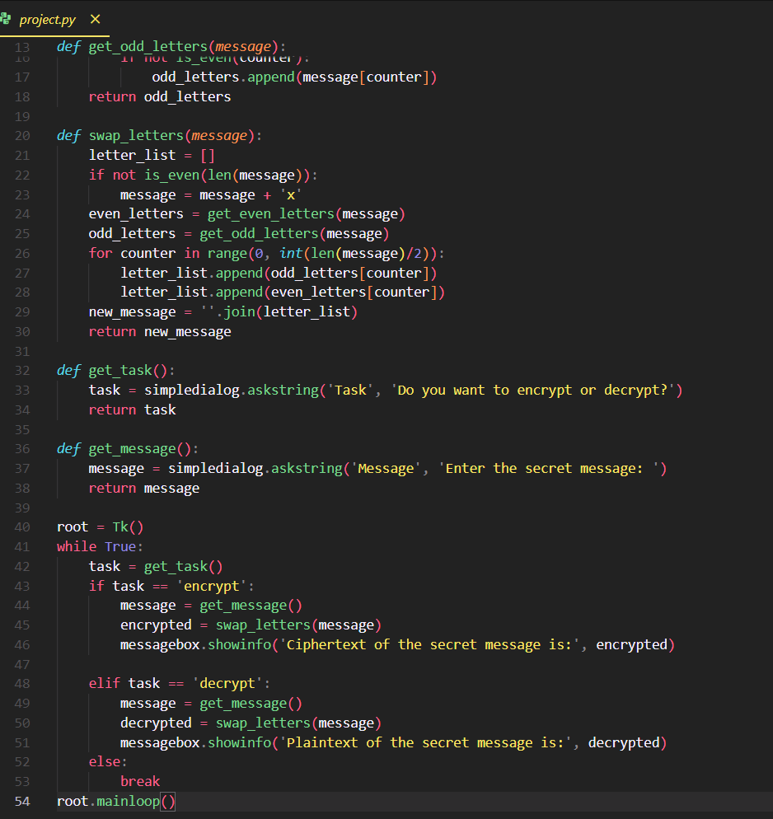
CODE SNIPPETS

Slide 10
References
https://medium.com/analytics-vidhya/python-based-gui-application-to-encrypt-and-decrypt-text-using-caesar-ci
pher-23ec88e75558

Slide 11
Thank You

